Slide 1
CSV File

Slide 2
What is a CSV?
How to read CSV file in Python?
Writing to a Python CSV
How to import CSV Python?

Slide 3
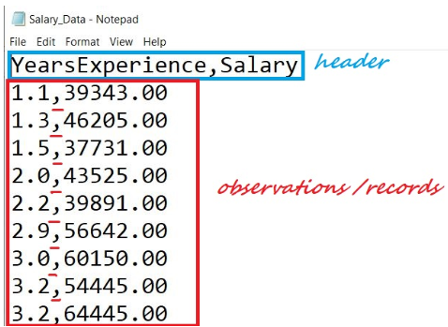
CSV stands for “Comma Separated Values.” It is the simplest form of storing data in tabular form as plain text.
Structure of CSV:

Slide 4
We have a file named “Salary_Data.csv.” The first line of a CSV file is the header and contains the names of the fields/features.
After the header, each line of the file is an observation/a record. The values of a record are separated by “comma.”
Reading a CSV
CSV files can be handled in multiple ways in Python.
Using csv.reader
Reading a CSV using Python’s inbuilt module called csv using csv.reader object.

Slide 5
Steps to read a CSV file:
1. Import the csv library
import csv
2. Open the CSV file
The .open()method in python is used to open files and return a file object.
file = open('Salary_Data.csv') type(file)

Slide 6
3. Use the csv.reader object to read the CSV file
csvreader = csv.reader(file)
4. Extract the field names
Create an empty list called header. Use the next() method to obtain the header.
The .next() method returns the current row and moves to the next row.
The first time you run next() it returns the header and the next time you run it returns the first record and so on.
header = []
header = next(csvreader)
header

Slide 7
5. Extract the rows/records
Create an empty list called rows and iterate through the csvreader object and append each row to the rows list.
rows = []
for row in csvreader:
rows.append(row)
rows
6. Close the file
.close() method is used to close the opened file. Once it is closed, we cannot perform any operations on it.
file.close()

Slide 8
using with() statement:
Syntax: with open(filename, mode) as alias_filename:
Modes:
‘r’ – to read an existing file, ‘w’ – to create a new file if the given file doesn’t exist and write to it, ‘a’ – to append to existing file content, ‘+’ – to create a new file for reading and writing

Slide 9
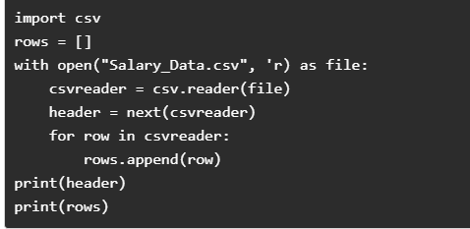
Using .readlines()
It returns all the lines in a file as a list. Each item of the list is a row of our CSV file.
The first row of the file.readlines() is the header and the rest of them are the records.

Slide 10
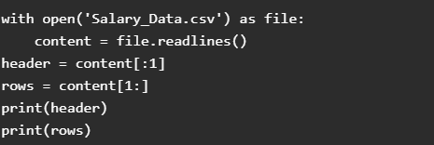
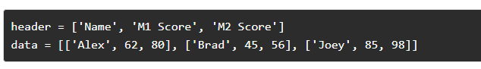
Writing to a CSV file
Using csv.writer
Let’s assume we are recording 3 Students data(Name, M1 Score, M2 Score)

Slide 11
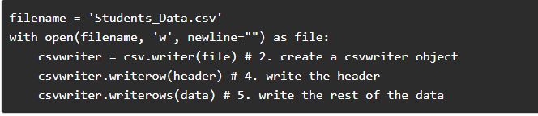
Steps of writing to a CSV file:
1. Import csv library
import csv
2. Define a filename and Open the file using open()
3. Create a csvwriter object using csv.writer()
4. Write the header
5. Write the rest of the data

Slide 12
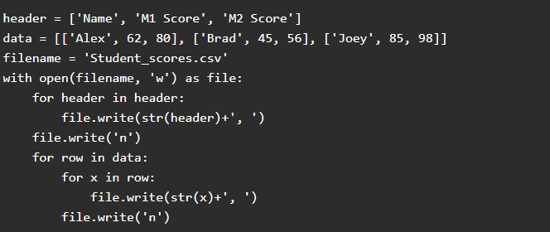
Using .writelines()

